Slide 1
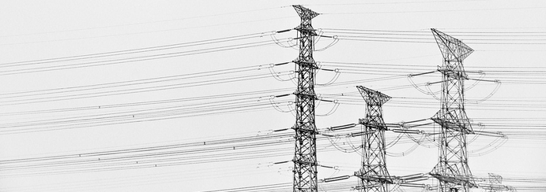


Team no: IBH-01
Team Members:
Pankaj Diwan- ECE 4-2
Baradwaj- EEE 2-2
Kartikey- CSE 2-2
Sai Akshay- IT 2-2
Do Right
Save Light

Slide 2
Problem Statement
Tracking of Electricity Generated, Traded and consumed has being a major issue past 1870,also illegal connections, wastage through suppliers.

Slide 3
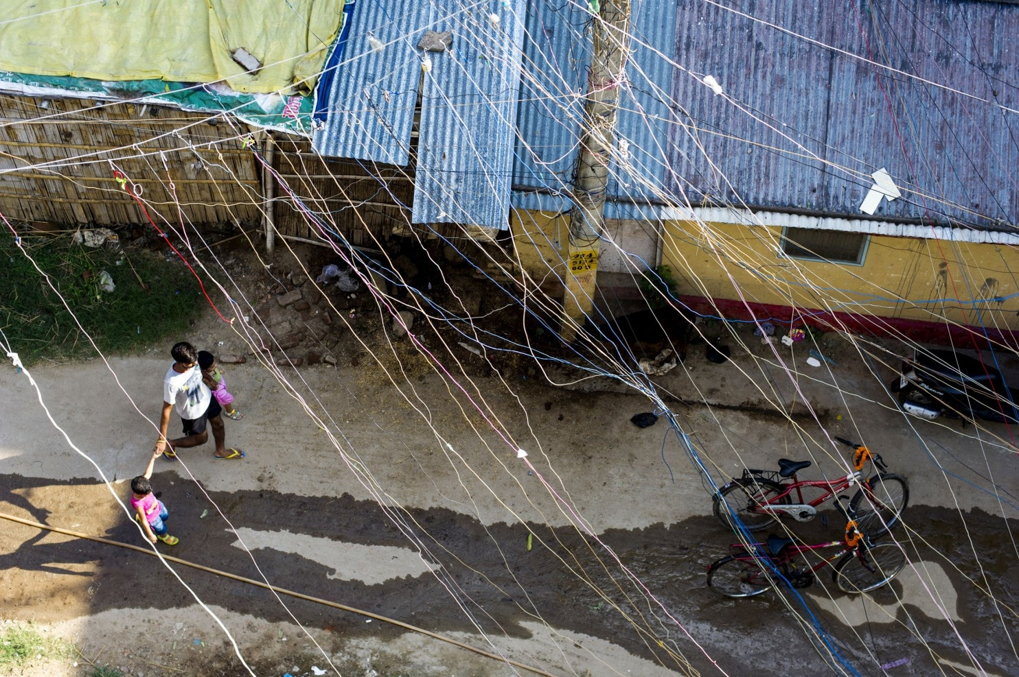
Statistics
Of the world’s 1.3 billion people who live without access to power, a quarter about 300 million live in rural India.

Slide 4
Present Scenario
Physical presence to enter the units burned,which may cause human errors.
Illegal connections due to different Process of entries into the sheets

Slide 5
Proposed Solution
Process electricity in blockchain for registration, calculation of cost, consumption through Distributed System from a single source.
Common platform for Electricity Providers.
Algorithm calculates the cost per unit as per standard cost strcutures

Slide 6
Stake Holders
Electric utility Companies (Tata Power, Torrent Power)
Solar panel suppliers

Slide 7
Smart Contract
Registration of User by electricity Provider
Calculate the Units as per Standard Charges
Payment with due Alert every month
Comparison of Electricity provided to user and utilization

Slide 8
Future Scope
IoT + Blockchain for connecting smart meters to calculate transactions.

Slide 9
References
→ https://www.washingtonpost.com/world/asia_pacific/indias-huge-need-for-electricity-is-a-problem-for-the- planet/2015/11/06/a9e004e6-622d-11e5-8475-781cc9851652_story.html?noredirect=on&utmterm=.65256086f568

Slide 10
Thank You
Team no: IBH-01
Do Right
Save Light

